Slide 1
The provision of the GDPR (general data protection regulation) is to ensure that personal data can only be gathered legally, under strict conditions, for a legitimate purpose, as well as to bring full control back to the data owners. It is open to interpretation. In fact, each organization has its own way to satisfy the new regulations and to demonstrate compliance.
In this application the gdpr is performed with crud operation and role rights .the implementation is performed in the application of hospital where each role has different rights to access .the admin will be mentoring the application by view of patient ,view of doctor and the actions performed by them
ABSTRACT

Slide 2
EXISTING SYSTEM
From an end user’s perspective, this leads to a lack of transparency and accountability of data management and raise the risks of personal data leakage. As all data management mechanisms are operating in a centralized system and under the control, may still be able to hand over personal data to an unauthorized without the end-user’s knowledge, as far as it is not investigated by supervisory authorities.
From an perspective, as the investigation from supervisory authority is occasionally carried out, it is challenging for an to declare that it has been continuously, securely and legally processing all personal data as required. This is of paramount importance for any to build trust with prospective clients.

Slide 3
PROPOSED SYSTEM
In this there are 4 actors the doctor, admin, patient and nurse. the admin holds the role of read in crud it carries the view of doctor ,patient and nurse. Once the appointment request has been sent by the patient the nurse checks the schedule of the doctor and allots the slot to concern doctors. The patient checks the profile and receives the allotted appointment date and time through mail.
The doctor will be having a login page after gets logged the particular doctor's profile will be shown and can view the case history with their complete details and does some updating in the application with certain remedies to change the patients history. The nurse holds the study case history of the patient and allotting the appointment is done by the nurse by checking the availability of the doctor.

Slide 4
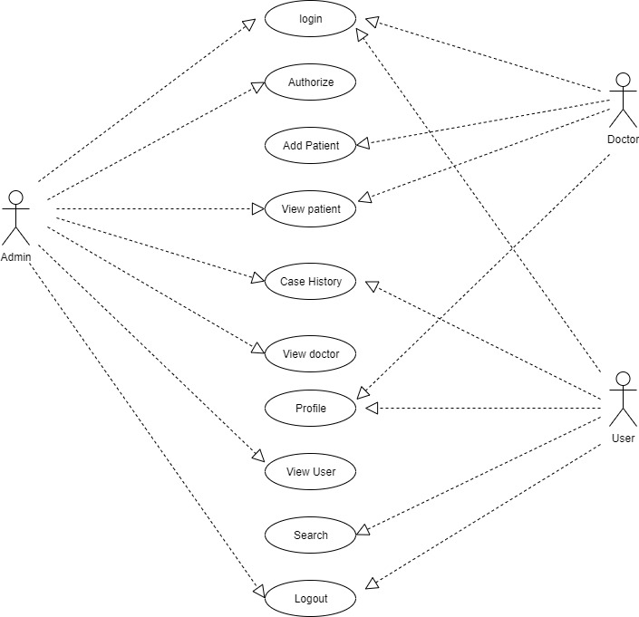
USE CASE DIAGRAM

Slide 5
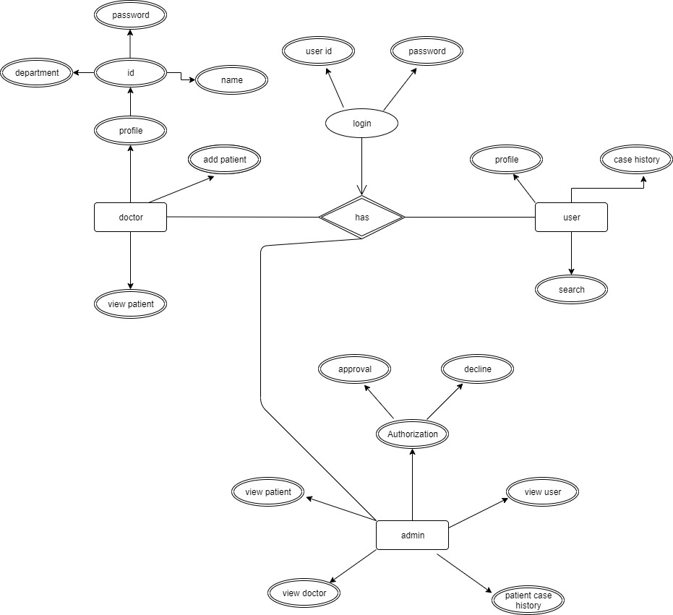
PROJECT FLOW

Slide 6
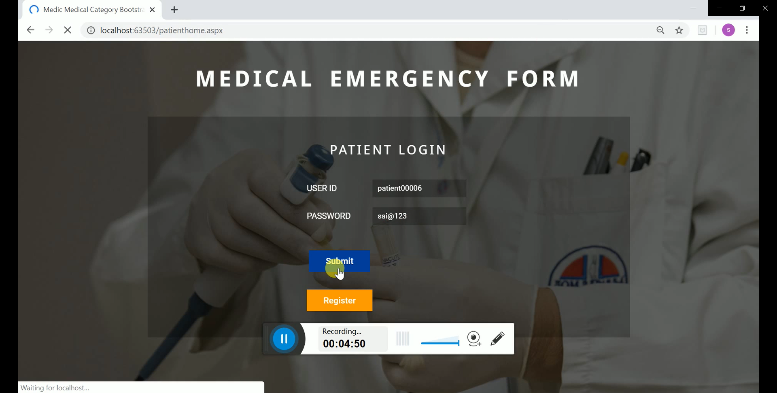
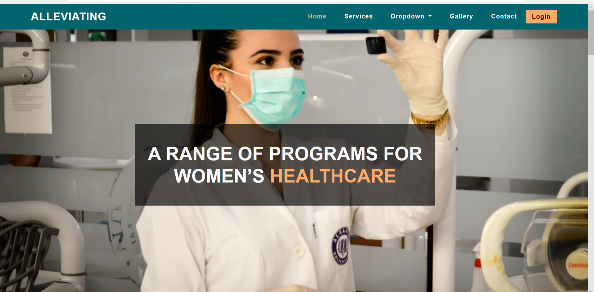
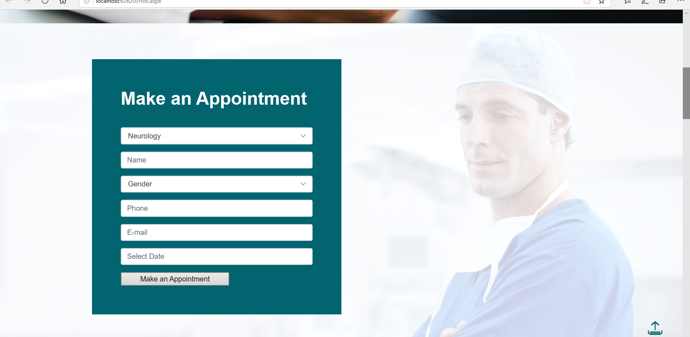
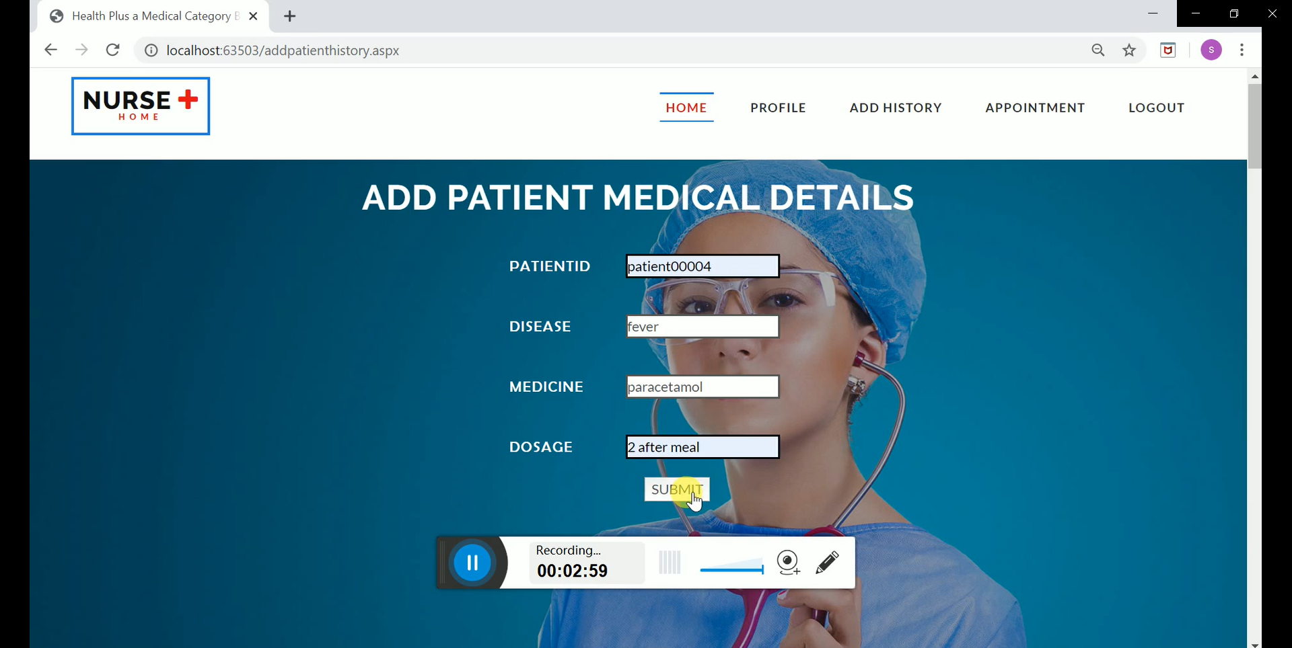
SCREEN SHOTS

Slide 7
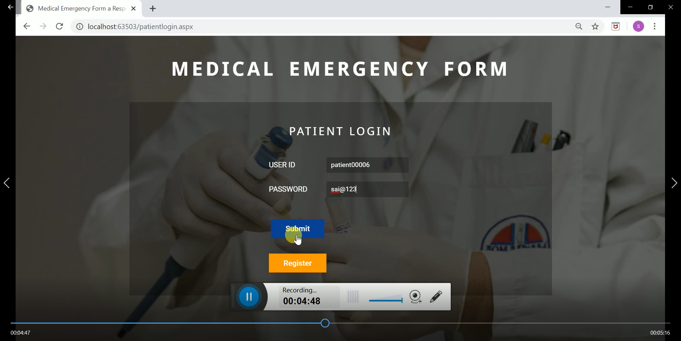
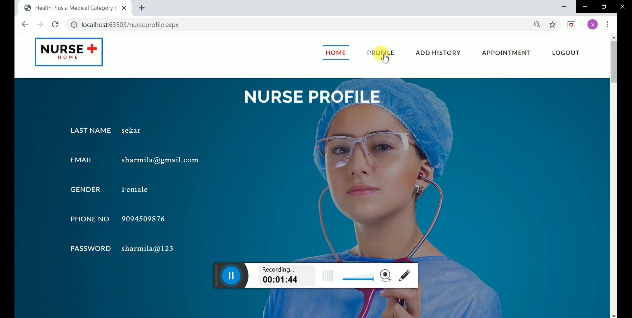
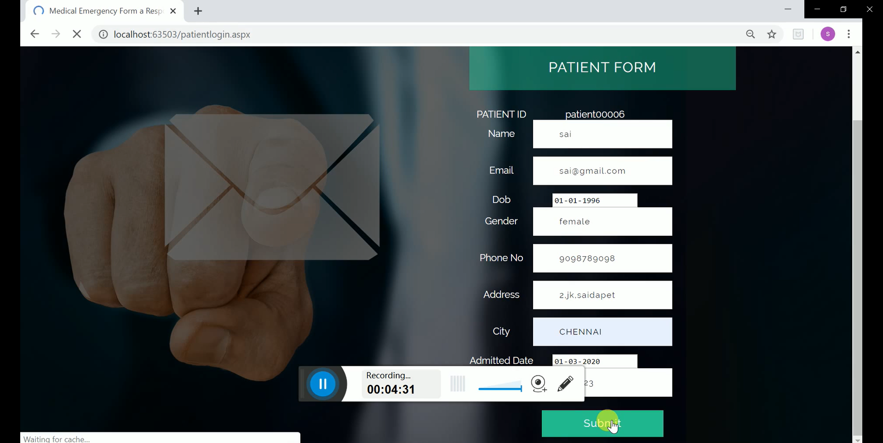
SCREEN SHOTS

Slide 8
SCOPE OF THE PROJECT
The platform interplays among an honest service of consuming data, a social networking ensuring that all processing activities over proﬁle data stored in the database are compliant with the GDPR. The feasibility and effectiveness of the design concept are, therefore, successfully demonstrated. In this regard, the crud is not trustworthy as some storage nodes might be malicious.
Thus, more mechanisms need to be implemented to resolve the lack of a trusted centralized activity. As a reward, the system is truly decentralized. As the processing of personal data refers to CRUD operations – which is under the mindset of data storage, an ambitious research direction is to provide computational capability on a role network.

Slide 9
Bottom Line And Future Enhancement
The platform interplays among an honest , a social networking ensuring that all processing activities over proﬁle data stored in the are compliant with the GDPR. The feasibility and effectiveness of the design concept are, therefore, successfully demonstrated. In this regard, the is not trustworthy as some storage nodes might be malicious.
Thus, more mechanisms need to be implemented to resolve the lack of a trusted centralized. As a reward, the system is truly decentralized. As the processing of personal data refers to CRUD operations – which is under the mindset of data storage, an ambitious research direction is to provide computational capability on a network.

Slide 10
THANK YOU

